Slide 1





Automatic Washing Machine Control System Using Verilog HDL

Slide 2
INTRODUCTION
Various real life scenarios can be represented by Finite State Machines like control system of an automatic washing machine.
Assigning the main stages of the process like Close door, fill water, add detergent, cycle, drain
and spin various states that can be implemented as a State Machine.
Writing a test bench to observe the working of the machine.
Using Xilinx ISE 14.7 to implement the control system.

Slide 3
STATE DIAGRAM

Slide 4
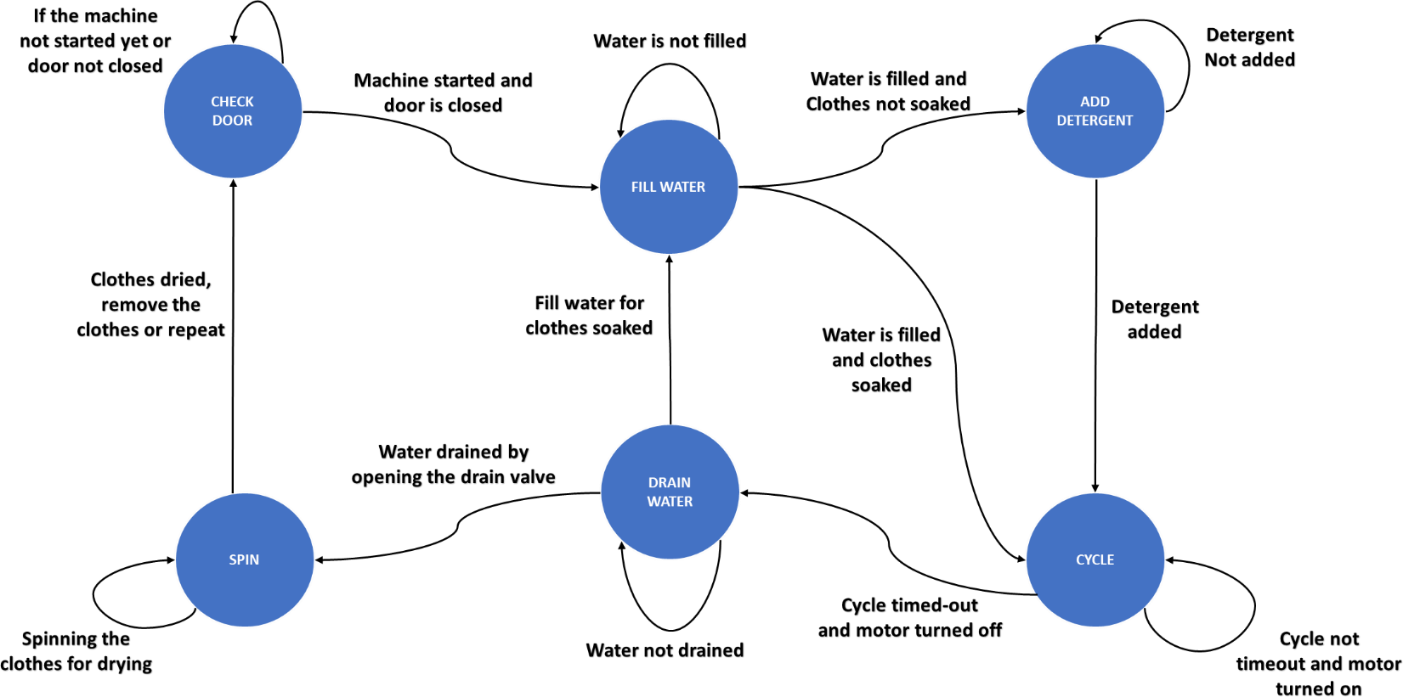

Slide 5
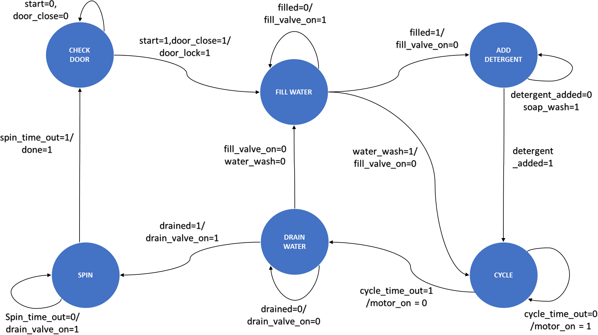

Slide 6
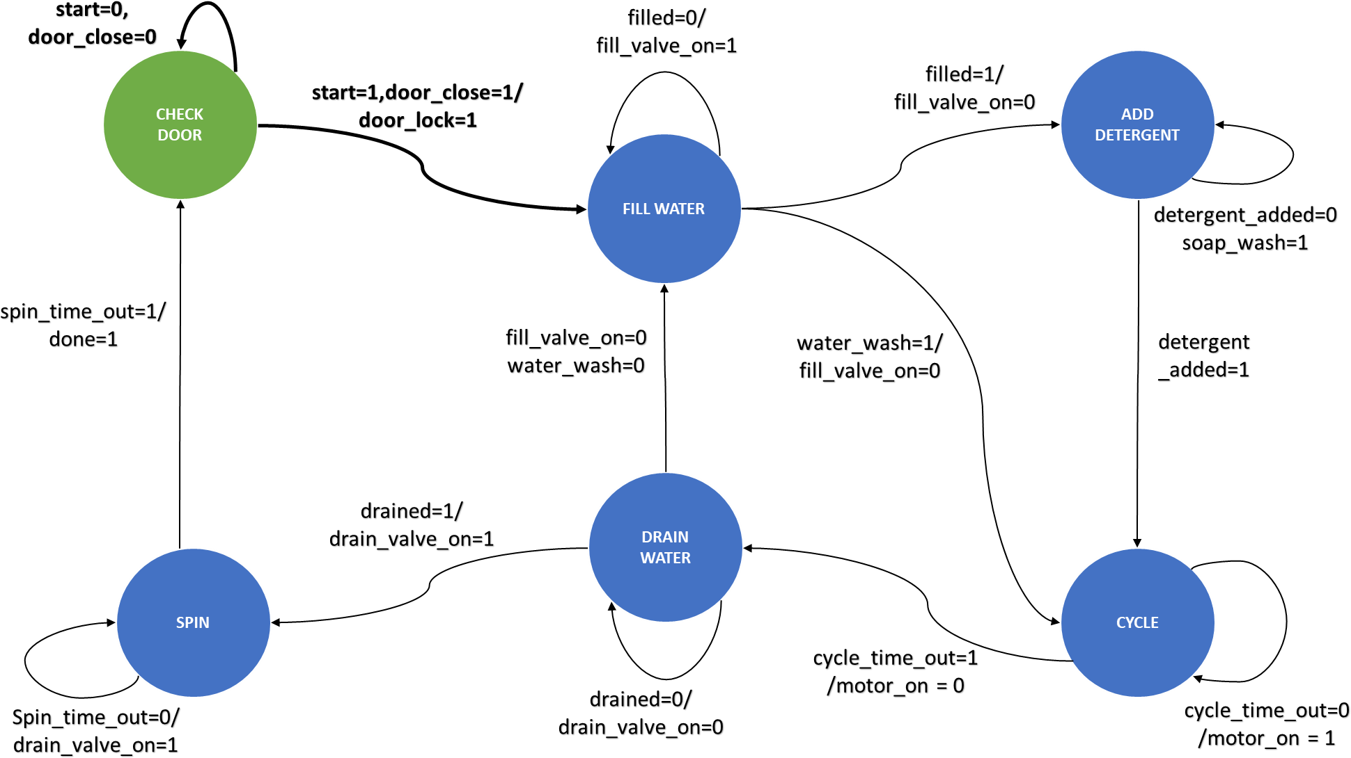

Slide 7
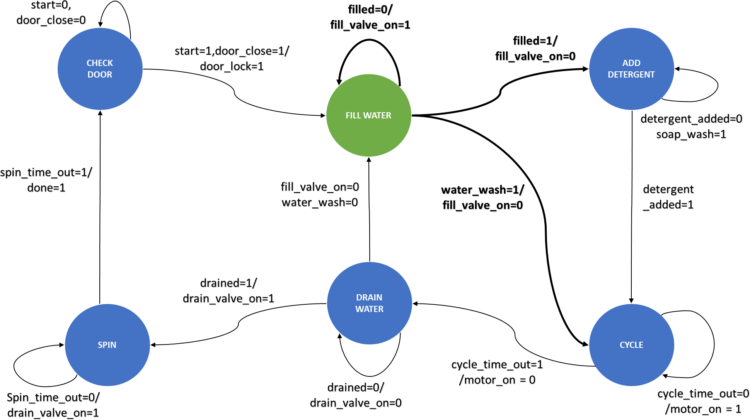

Slide 8
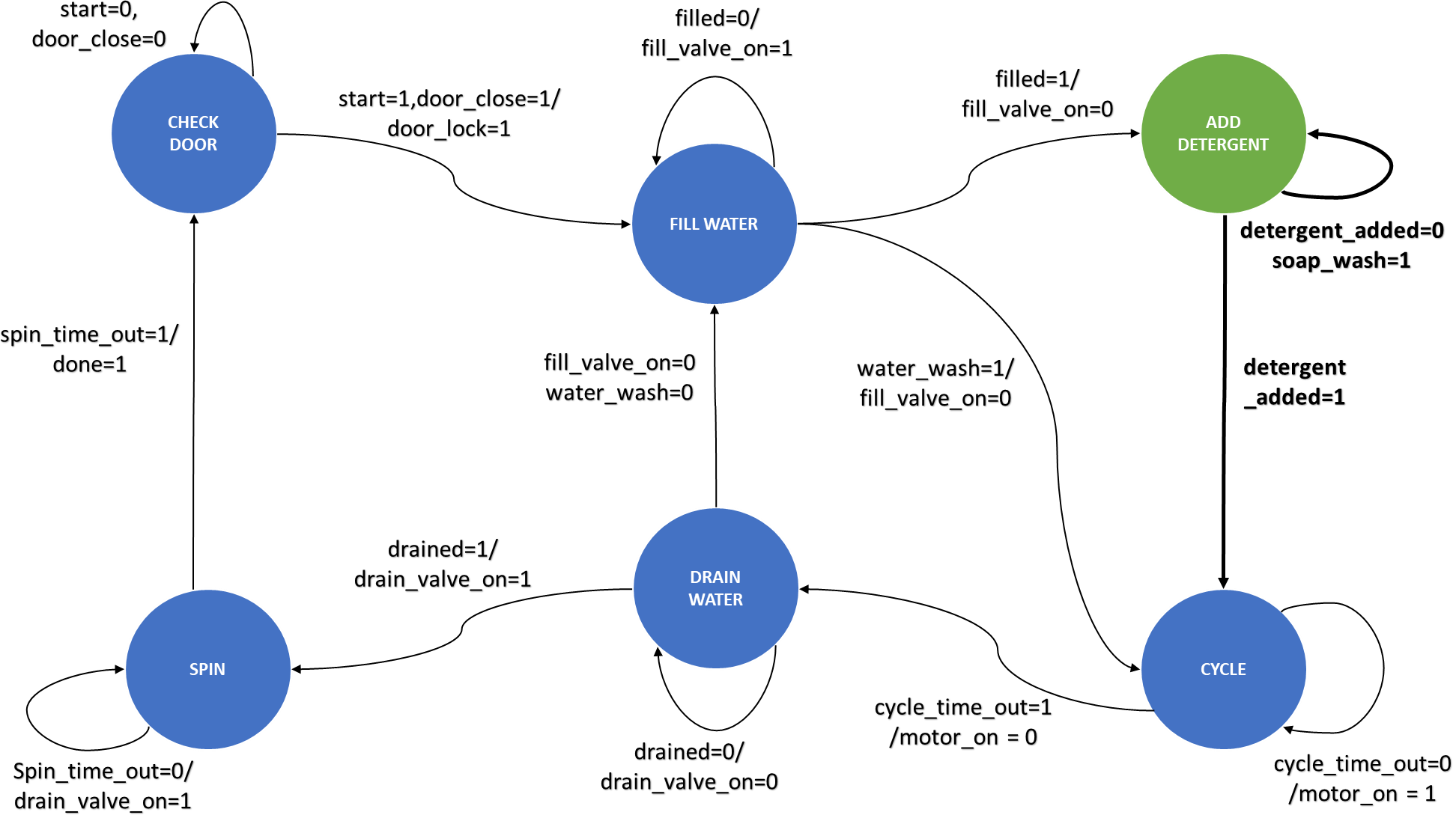

Slide 9
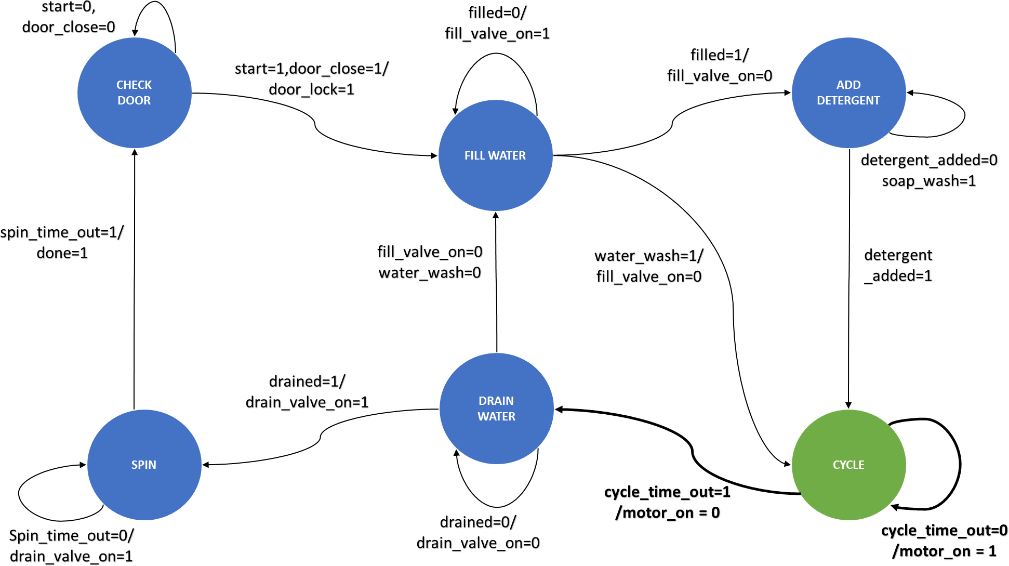

Slide 10
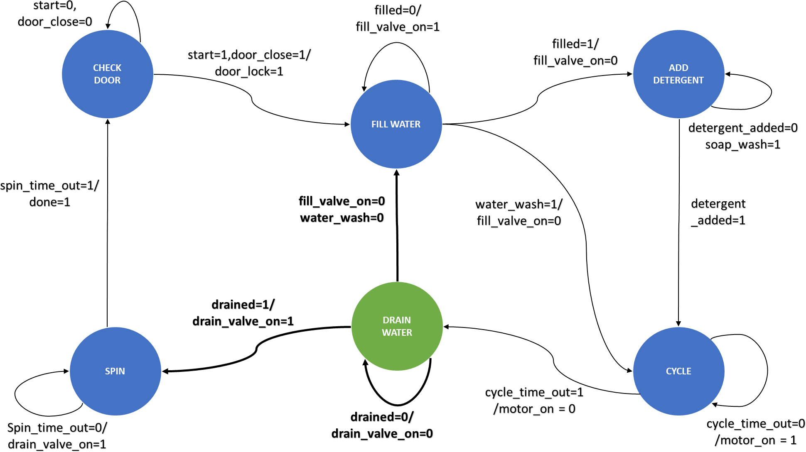

Slide 11
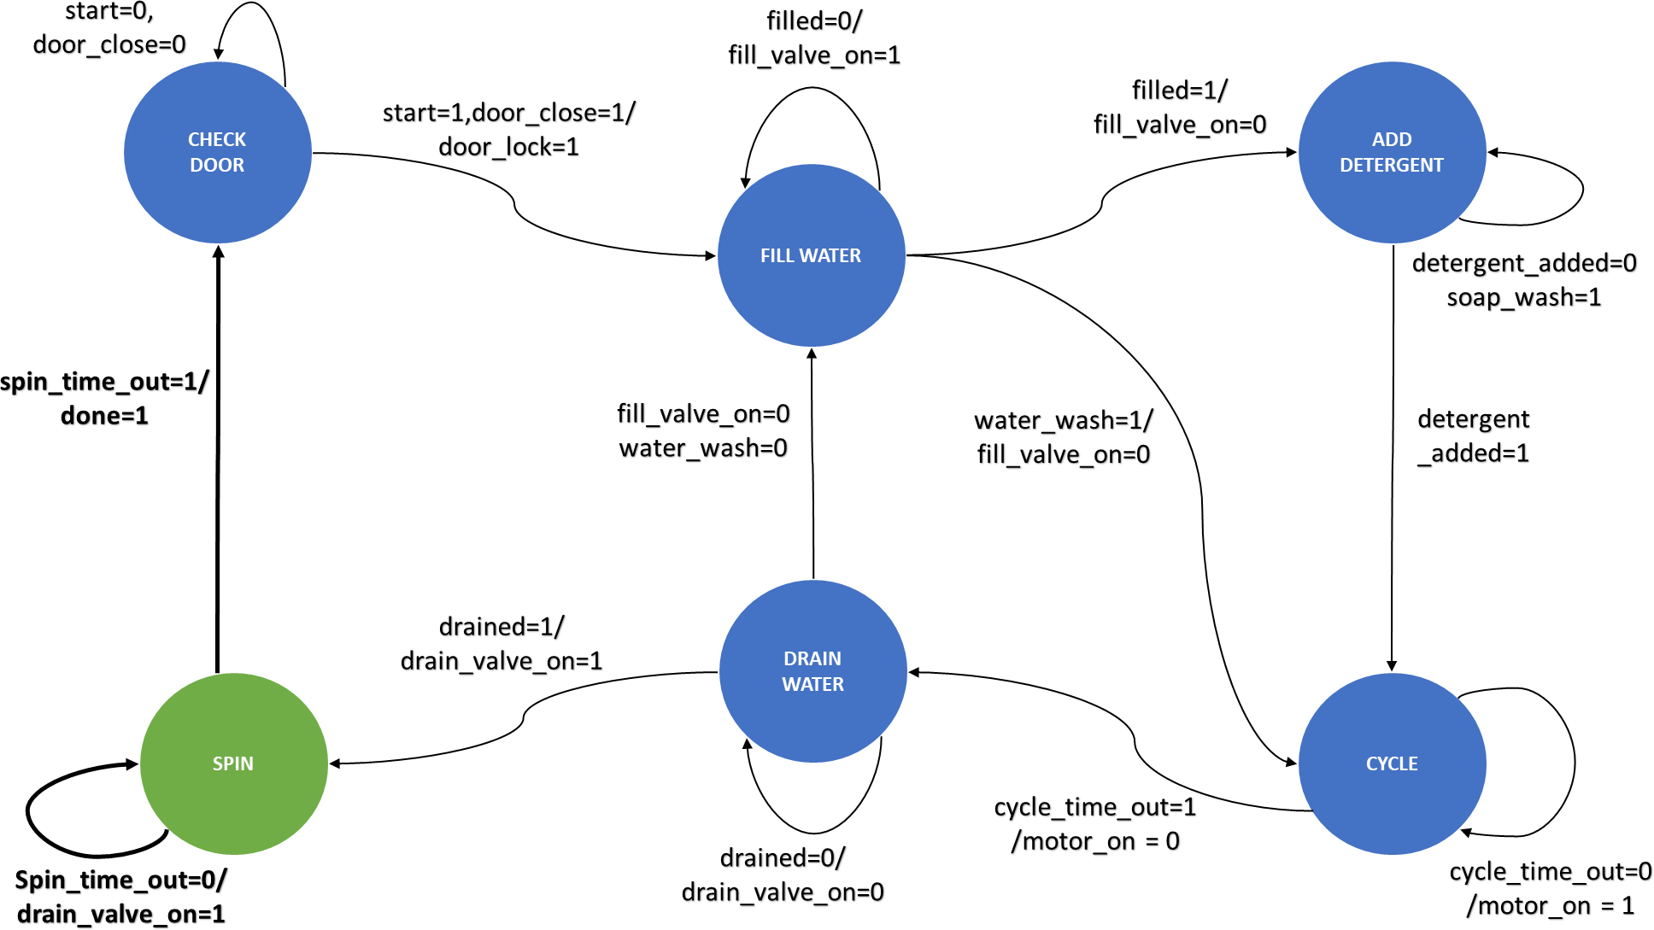

Slide 12
RESULTS

Slide 13
FUTURE SCOPE AND APPLICATIONS
1
The automatic washing machine has been implemented on Verilog HDL using ModelSim.
2
The current project can be implemented on FPGA to demonstrate the code.
3
The project is based on Finite State Machine (FSM). Various other projects based on FSM can be implemented using the current project code as the basis.
4
More functionality may be included like different modes to wash the clothes based on the clothing material, temperature etc

Slide 14
Simulation Result

Slide 15
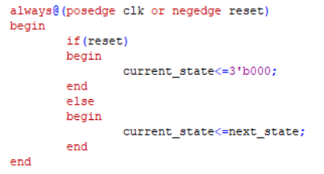

Slide 16
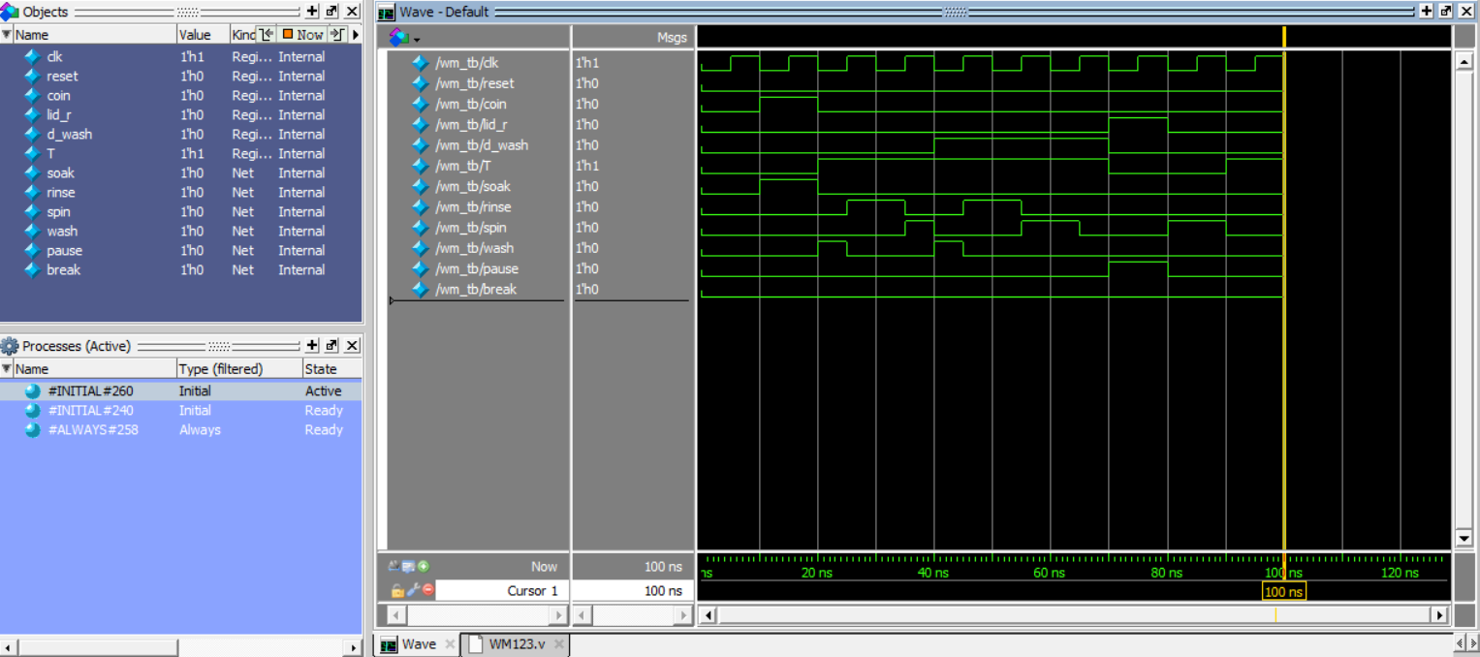

Slide 17

THANK YOU

